Slide 1
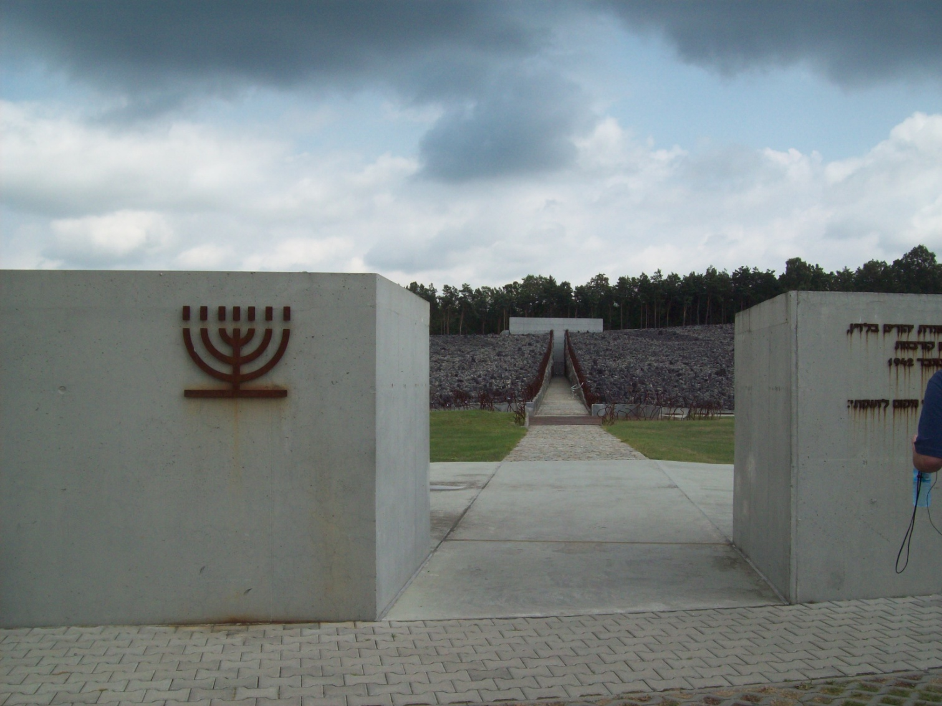
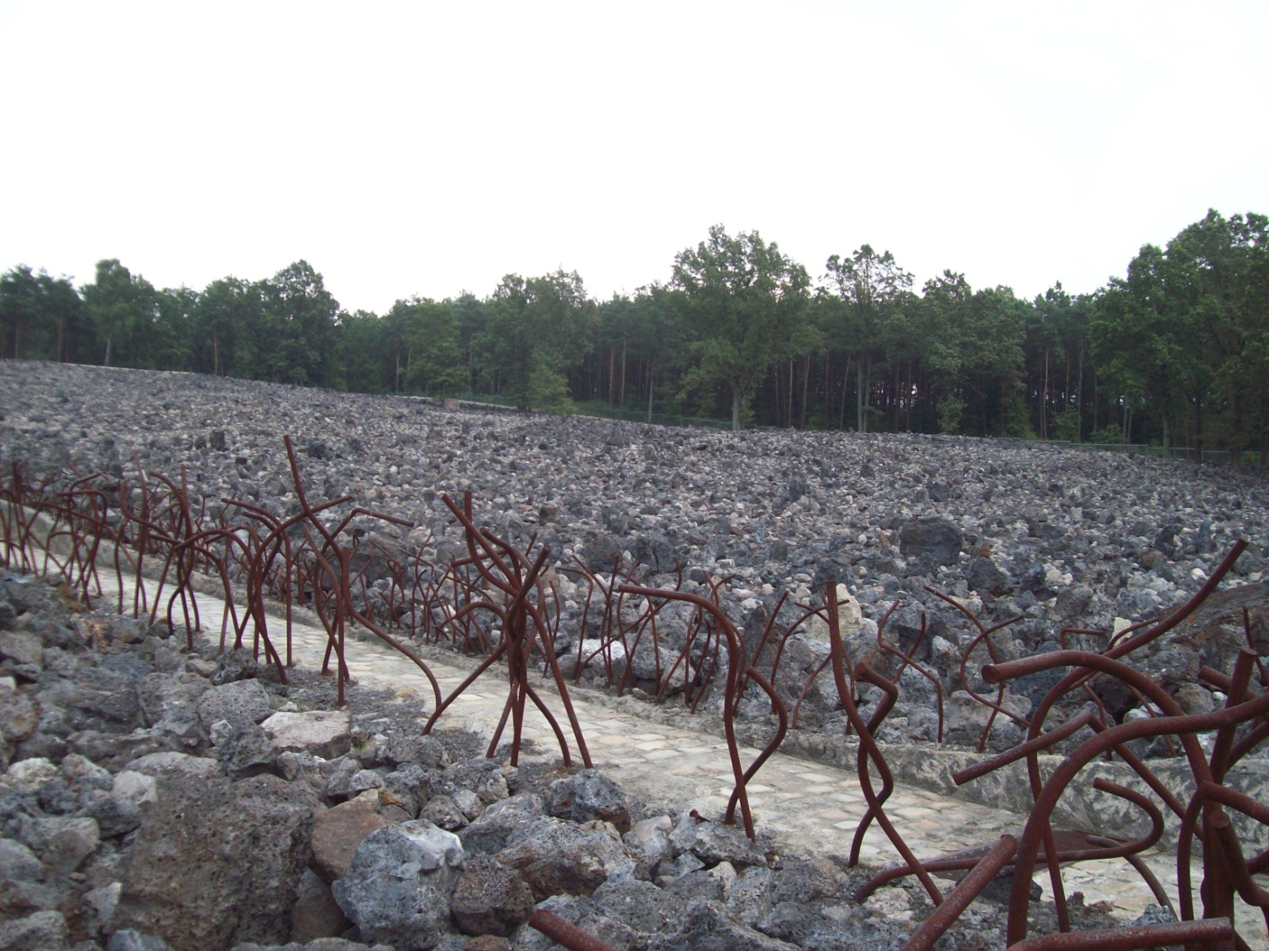
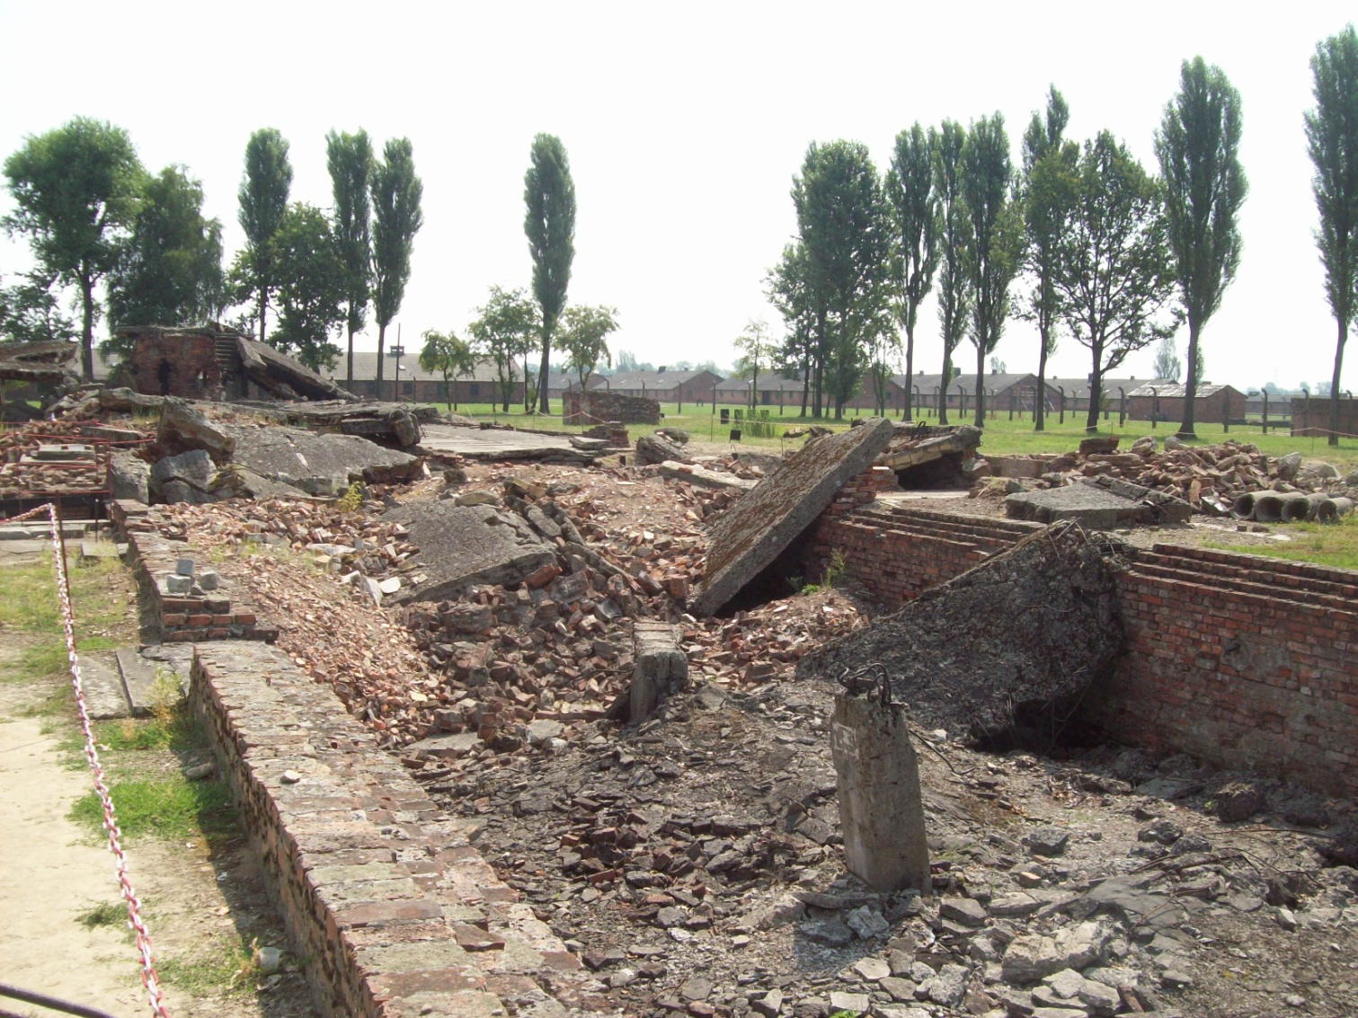
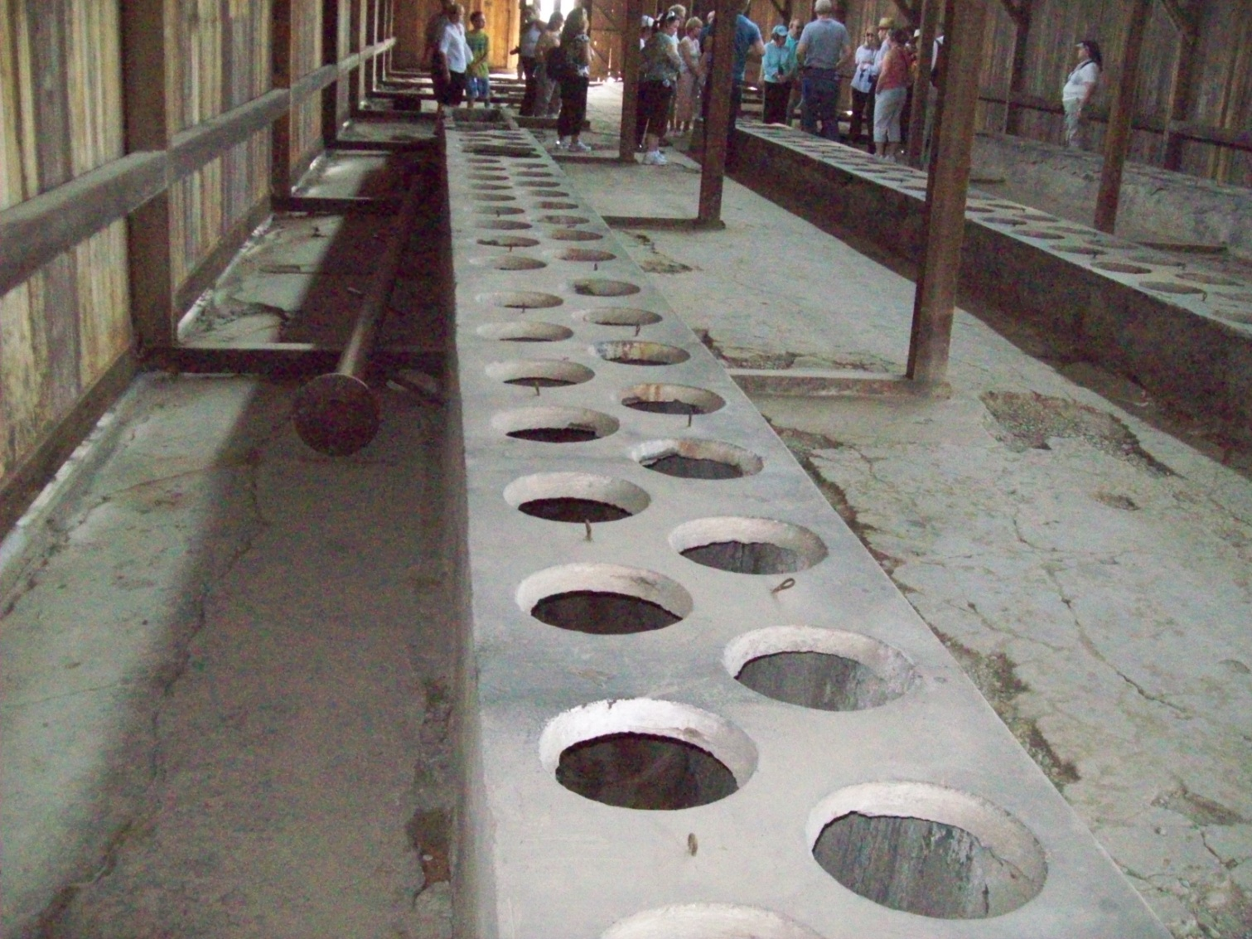
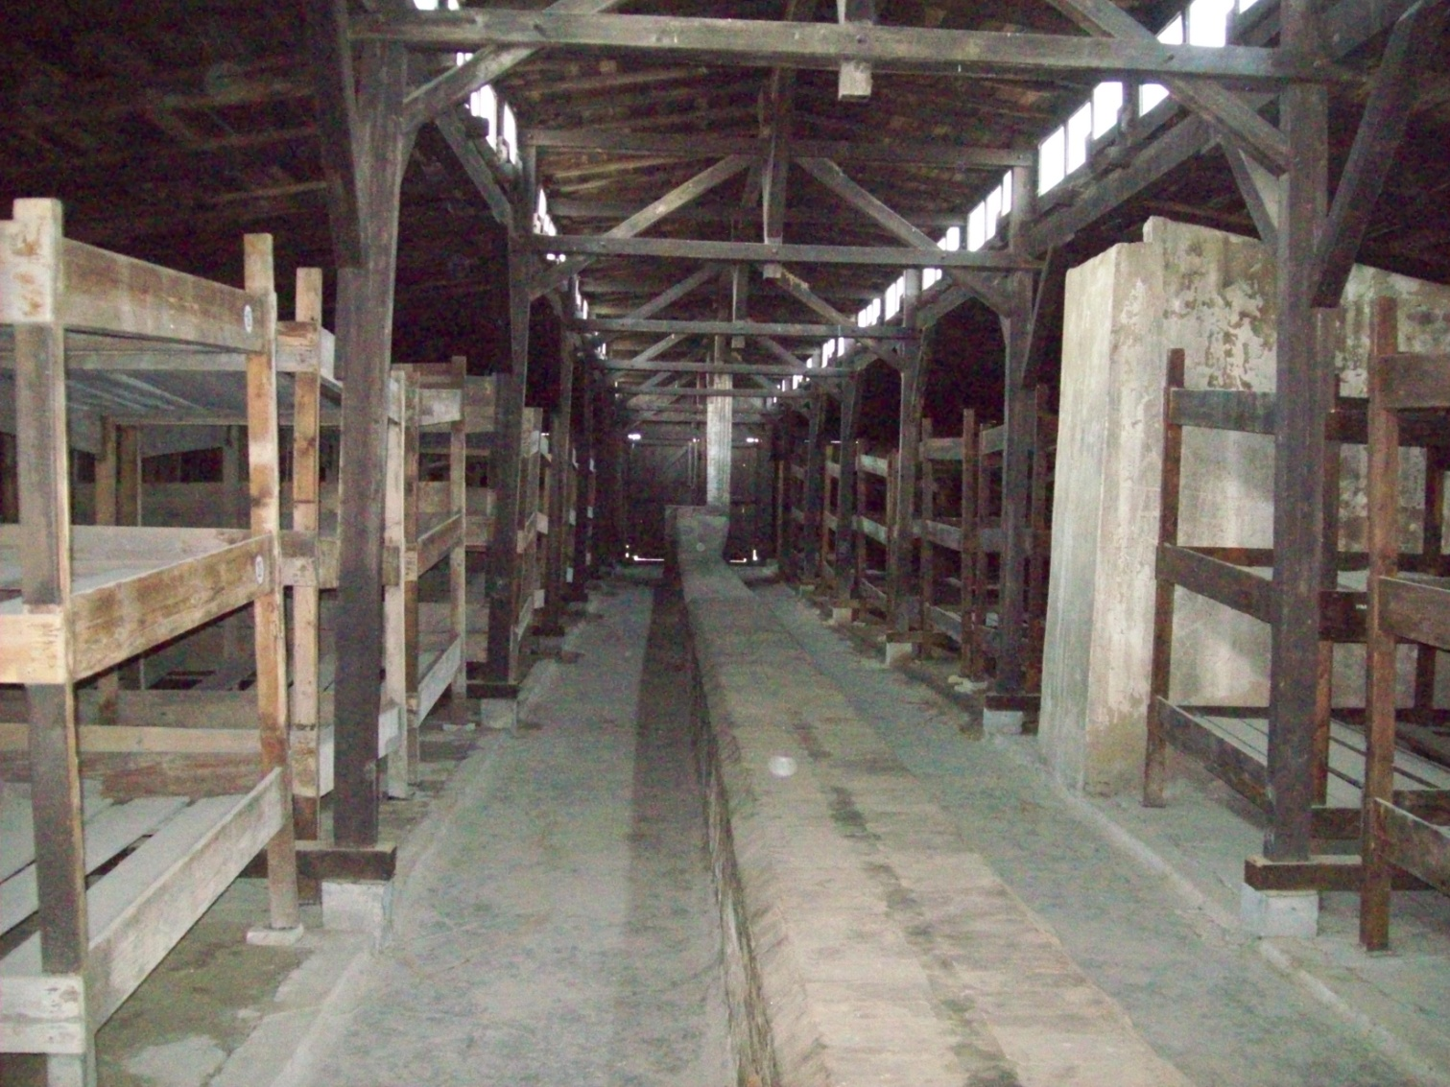
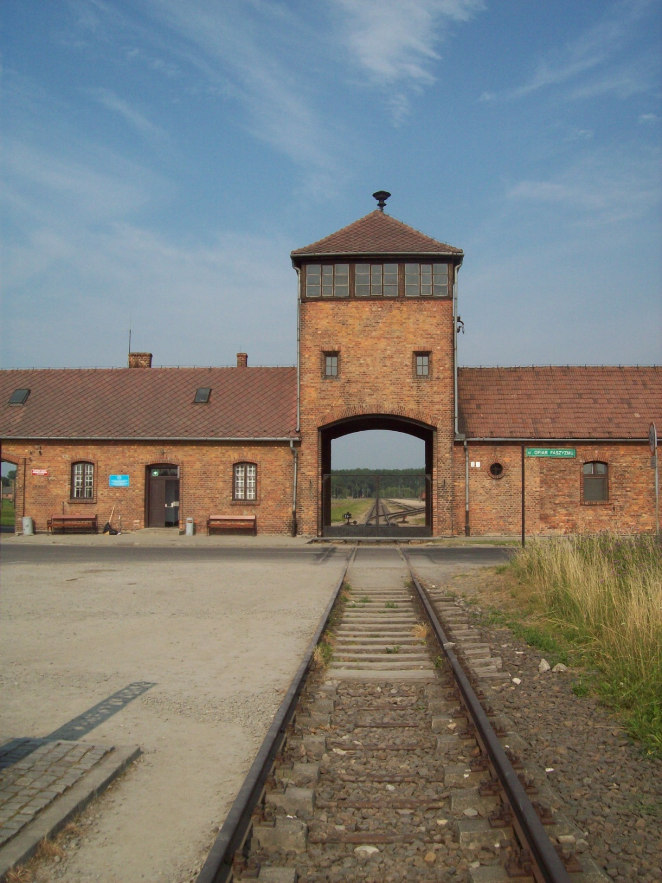
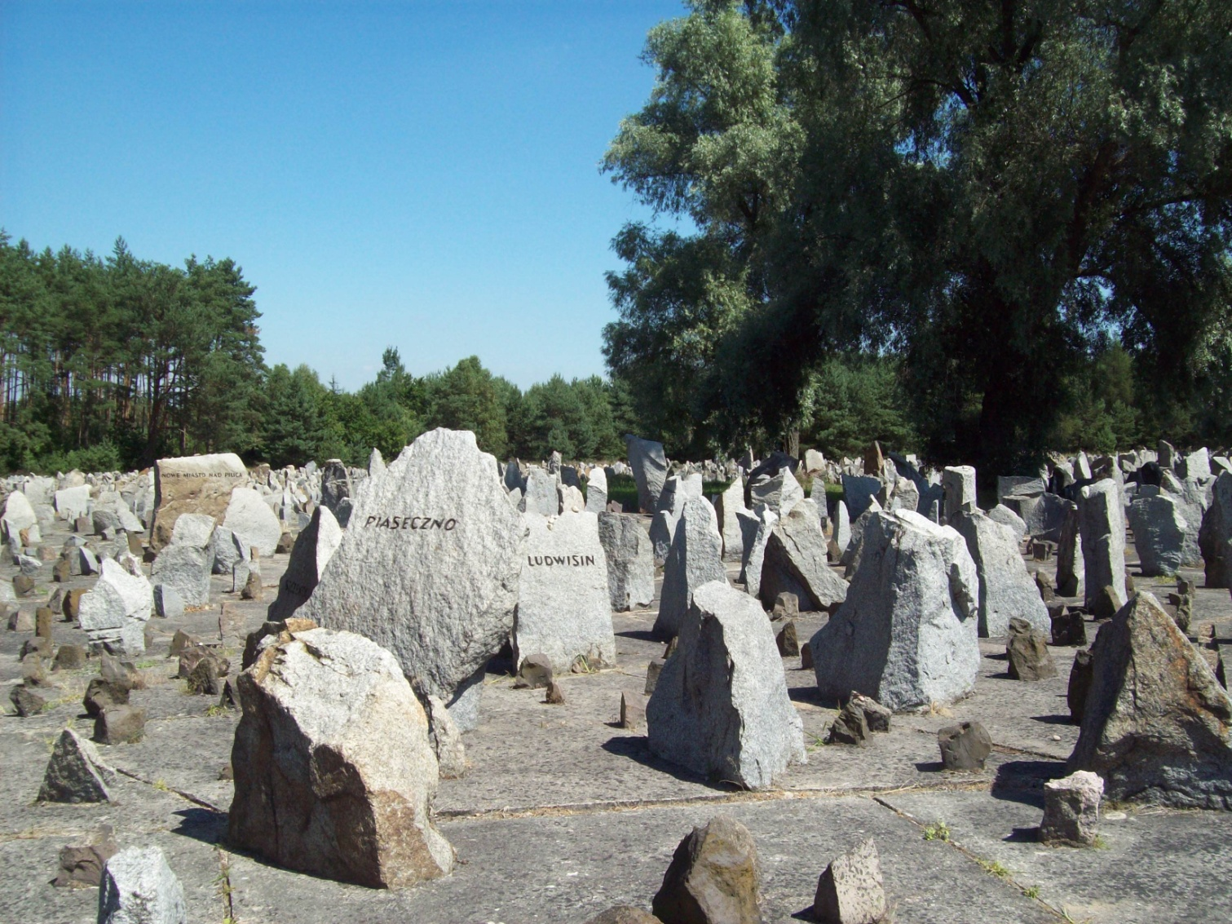
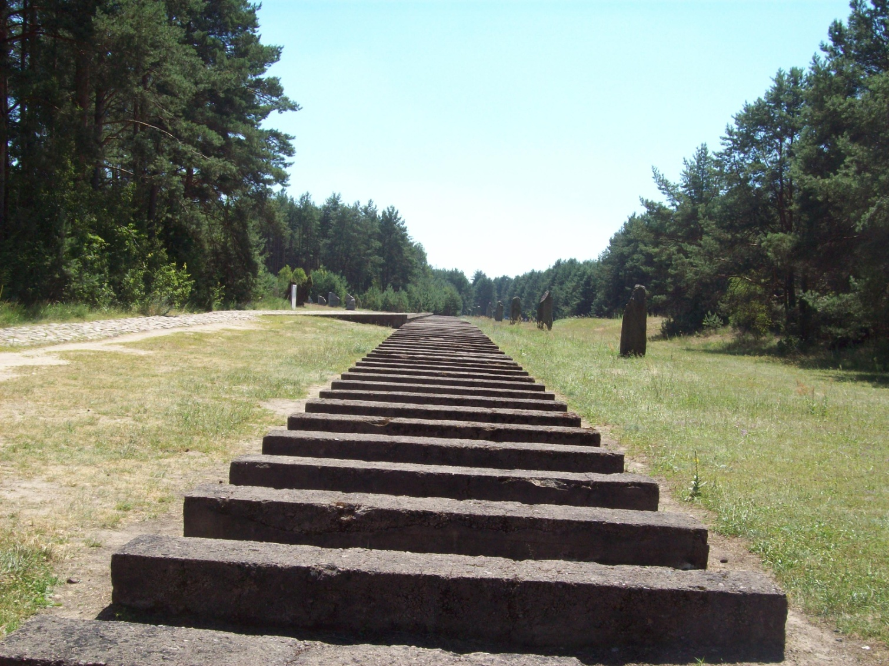
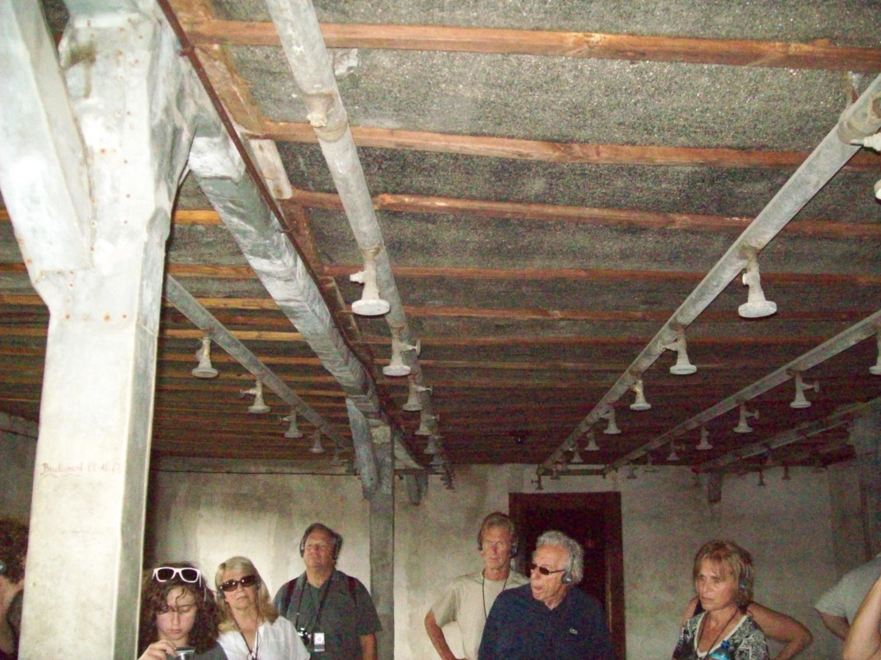
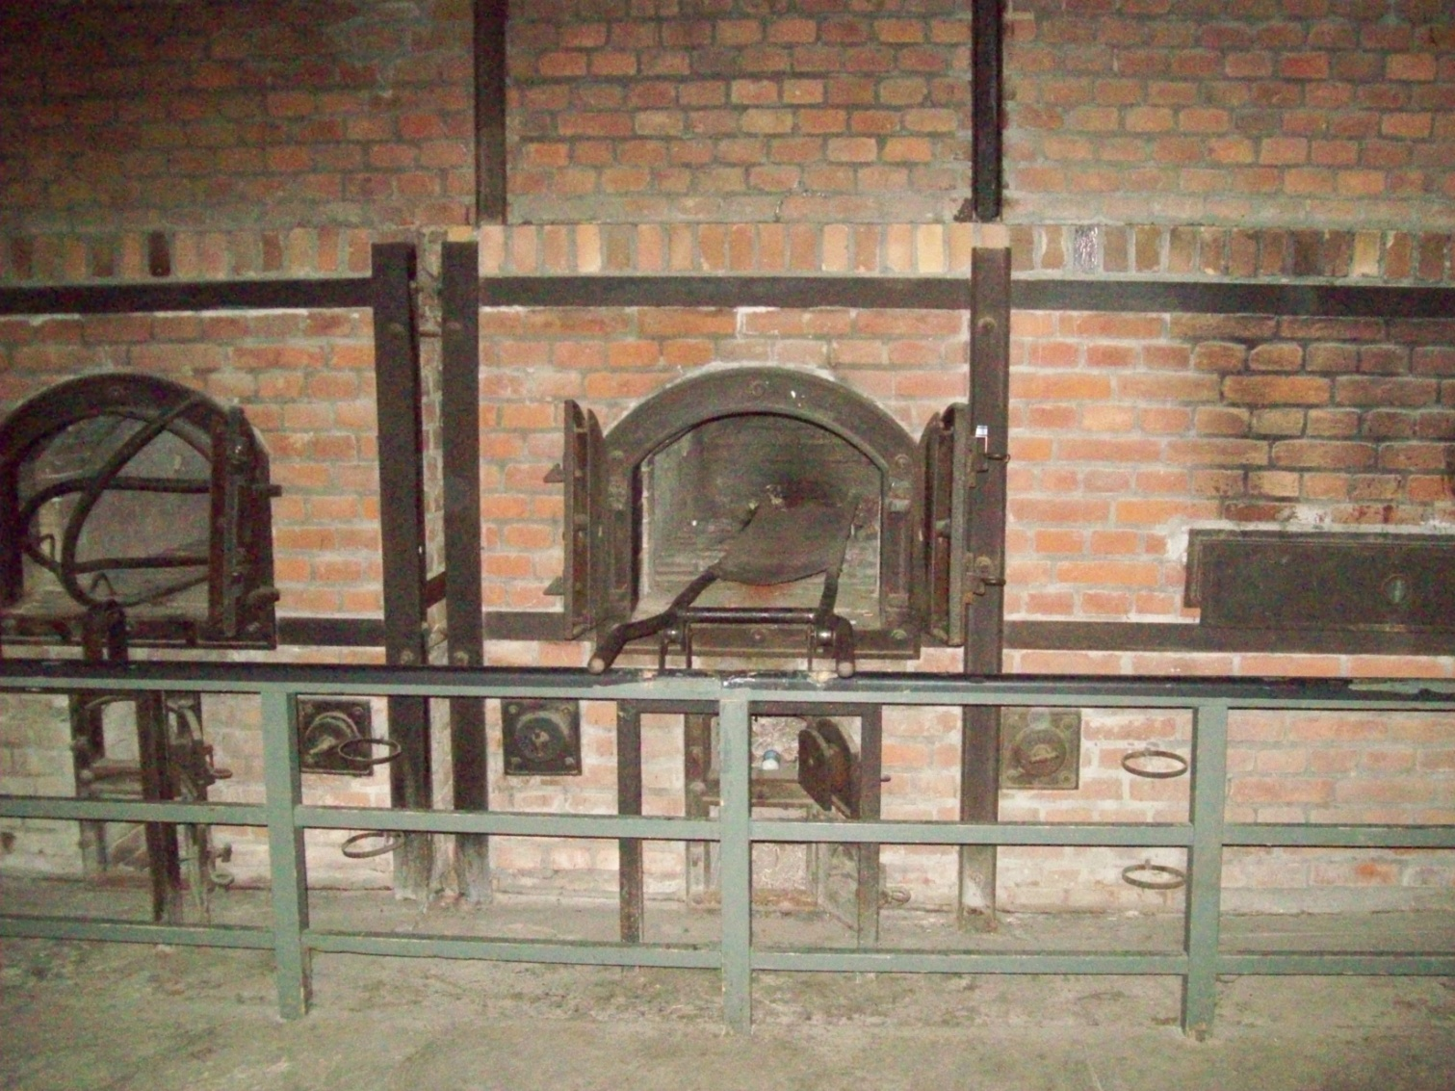
Witnessing the Eye-Witness Sites: Researching Holocaust Concentration Camps in Poland
Dr. Lee Prescott, Associate Professor of English, Palm Beach Atlantic University
Introduction
Adolf Hitler and his Nazi Party envisioned a 1,000 year Reich
Wherein they, and other so-called Aryan Germans, would rule the world
All undesirable people, all those “unworthy of life” would be killed
Of prime importance to the Nazis was the complete elimination of the Jews
This systematic goal to murder all European Jews was known as The Final Solution
Certain sub-human groups, such as the Slavic people, would be allowed to live so as to be slaves
Future plans
My scholarly interest in the Holocaust continues to be all-consuming
I plan to work with renewed dedication in my scholarly analysis of Jewish survivors’ autobiographies, expanding the insights contained in my first book as I draw from what I learned during my trip to Poland
Throughout the Nazi empire, there were over 1,000 concentration camps and slave-labor camps
All countries under Nazi rule had such camps
From all over Europe, Jews and others selected for death (including Roma, Jehovah’s Witnesses, and homosexuals; also Catholic priests and nuns and Protestant clergy who stood up to the church) were sent to concentration camps
But the major extermination camps—places existing only to process at a then-highly efficient, scientific, and productive way—were localized in Poland
The most infamous were Auschwitz, Treblinka, Majdanek, and Treblinka
Krakow (July 15-17)
Visit Krakow History Museum, located in Oscar Schindler’s factory; walk through Kazimierz (Jewish Quarter); see Galicia Jewish Museum and visit with young scholars there; dinner with U.S. Consul General and other Consul members; walk through Old Town; see Krakow’s castle and cathedral; attend all Chopin piano concert at the Wieliczka Salt Mines
Spend six hours at Auschwitz-Birkenau (July 16)
Due to extreme heat wave (over 100 degrees) and the close relationship between Auschwitz-Birkenau State Museum and the USHMM, our group was allowed in 90 minutes earlier than usual.
Depart Poland (July 18)
The QI grant I received helped pay for my trip to see those very sites on a trip
Organized and led by the United States Holocaust Memorial Museum
Itinerary: Warsaw (July 10-12)
Toured Old Town; walked through area of (now destroyed) Warsaw Ghetto; visit Jewish Cemetery; see Jewish Historical Institute; have lunch with the US Ambassador to Poland; tour Warsaw Rising Museum; go to Treblinka
As with many other extermination camps, the Nazis completely razed Treblinka as the Allied Armies approached. Nothing remains from the killing days except the train tracks.
Results of Trip to Poland
I now have seen many important places in Poland that are essential to grasping the complexity of the Holocaust. Thanks to the USHMM’s trip and PBA’s QI grant, what I have learned will produce valuable insights in my scholarly writing.
Spending time in Warsaw, walking around areas that don’t exist anymore (such as the Warsaw Ghetto), increased my knowledge of European Jewry and the hardships incurred during Nazi occupation
Seeing the stones at Treblinka, each representing a town or village where Jews were deported, helped me grasp the enormity of the Final Solution
Going to Majdanek allowed me to see the gas chambers and crematoria—those emblems of the horrors of the Holocaust— and barracks containing thousands and thousands of pairs of shoes, silent witnesses to the people who owned them. Majdanek is now, and was then, within an easy walk of Lublin, a major city
Walking around the small area of Belzec brought me face to face with the Nazis’ scientifically organized pursuit of more efficient mass murder; the only living things there are trees that existed during the time of the camp—they are the witnesses
Spending 6 hours at Auschwitz-Birkenau taught me a great deal about the two camps’ functions—their physical proximity, their material construction, and their residue of evil. I have read countless memoirs that featured Auschwitz; now I have seen, with my own eyes, key elements of the camp
.
Estimated Number of Jews killed in the Final Solution
(not a complete list)
Poland 3,000,000 90% of Jewish population
Baltic Countries 228,000 90% of Jewish population
Germany/Austria 210,000 90% of Jewish population
Slovakia 80,000 83% of Jewish population
Greece 75,000 83% of Jewish population
Netherlands 54,000 77% of Jewish population
France 90,000 26% of Jewish population
Lublin/Majdanek (July 13-14)
Travel to Lublin; walk through Old Quarter
Majdanek Concentration Camp (July 13)
Belzec Extermination Camp (July 14): this was the home of the scientific study of mass killing

