Slide 1
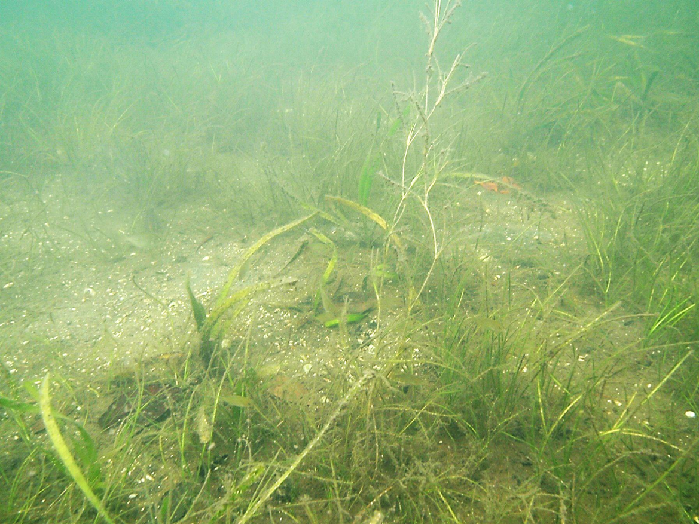
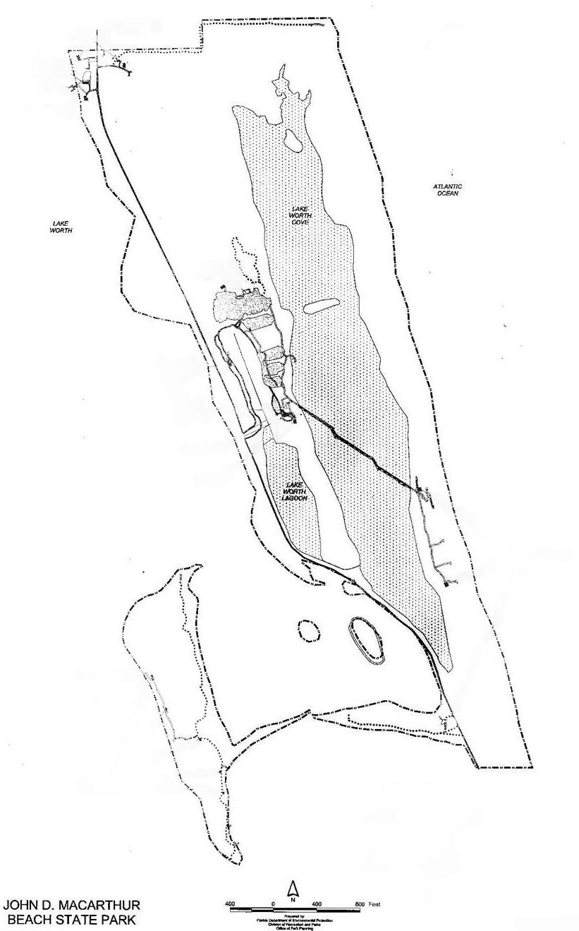
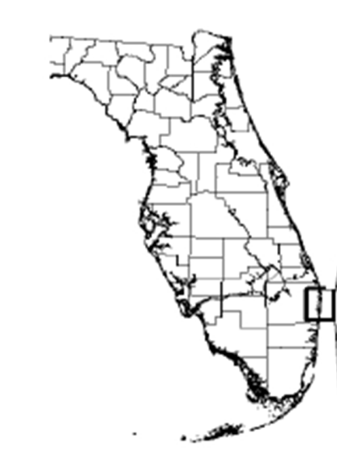
Biodiversity of submerged aquatic vegetation in Lake Worth Cove, an undeveloped region of Lake Worth Lagoon, Palm Beach County, Florida.
Thomas C. Chesnes*, Scott Duncan**, and Kathryn Swick*
*Department of Biology, Palm Beach Atlantic University
**John D. MacArthur Beach State Park, Florida Park Service
ACKNOWLEDGEMENTS
This project was funded by grants from the Community Foundation of Palm Beach and Martin Counties and the Palm Beach Atlantic University Quality Initiative Grant Program. J. Marras-Tate, C. Jabaly, E. Cowan, M. Wallrath, and S. Waddell assisted in data collection; E. Coolican and P. Klarmann provided assistance in preparation of this presentation.
Lake Worth Lagoon is an urban estuary and the primary estuarine water body in Palm Beach County, Florida. It was estimated that over 87% of the natural shoreline vegetation has been disturbed– in many cases replaced by seawalls, bulkheads, or shoreline armoring. A portion of northern Lake Worth Lagoon is protected, located within the boundaries of John D. Macarthur Beach State Park, including the nearly fifty hectare, semi-enclosed Lake Worth Cove. Nondestructive field surveys of submerged aquatic vegetation were initiated within the cove in 2009.
All seven of Florida’s seagrass species were found in this location, including the federally listed threatened species Halophila johnsonii (Johnson’s seagrass) as well as Ruppia maritima (widgeon grass), a species which has never been documented within the park and rarely documented within the lagoon. Along with the Indian River Lagoon, Lake Worth Cove has the highest seagrass diversity of any estuary in the Western Hemisphere.
J.D. MACARTHUR BEACH STATE PARK
PORT OF PALM BEACH
Sympatric species Ruppia maritima, Thalassia testudinum, and Halodule wrightii in the estuarine waters of John D. Macarthur Beach State Park.
NORTHERNMOST COVE
Mud / Silt Sediments
Shallow, exposed at low tide
Sparse distributions of Halophila johnsonii and Halodule wrightii (shoal grass)
WEST PALM BEACH
NORTH COVE
Mud / Sand Mix
Average depth 1m; shallower near island and shoreline
Halodule wrightii dominant; some dense patches of Syngodium filaforme (manatee grass), also Halophila johnsonii, Halophila englemanii (star grass), and Thalassia testudinum (turtle grass) present.
NORTH BOARDWALK
Mud / Sand Mix
Halodule wrightii dominant; dense patches of Syngodium filaforme near boardwalk. Also Halophila johnsonii, Halophila englemanii, Halophila decipiens (paddle grass), and Thalassia testudinum present. Macroalgae including Calupera sp., Halemeida sp., and Penicillus sp. were common.
Connection to Lake Worth Lagoon (Burnt Bridge)
SOUTH BOARDWALK
Mud / Sand Mix, very shallow on east side, exposed at low tide
All seven of Florida’s seagrasses were present in this region, including Ruppia maritima. This was the first reported occurrence of Ruppia in the Park’s waters. Halodule wrightii was the dominant seagrass.
SOUTHERNMOST COVE
Mud / Silt Sediments, exposed at low tide
Ruppia maritima, Halophila johnonii, and Halodule wrightii were found in this location with decreasing densities in the southernmost regions.
BOYNTON BEACH
Lake Worth Lagoon (PBC DERM)

