Slide 1
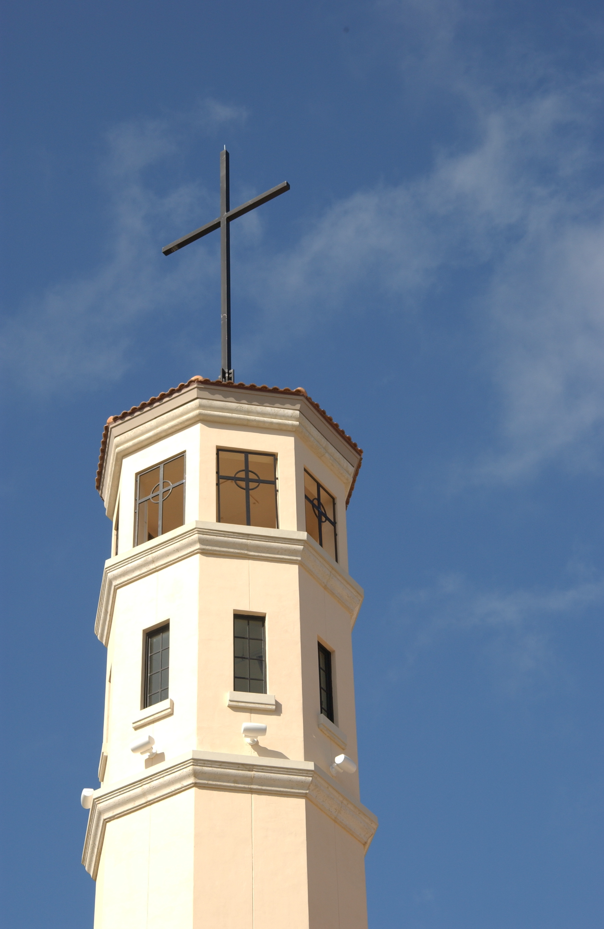
The Christian College Phenomenon: Inside America’s Fastest Growing Institutions of Higher Learning
Edited by Samuel Joeckel and Thomas C. Chesnes
AVAILABLE SPRING 2011
Abilene Christian University Press
Institutions affiliated with the Council for Christian Colleges and Universities (CCCU) have experienced phenomenal growth in the last twenty years. In fact, whereas public institutions of higher learning in the United States experienced a 3% growth in enrollment from 1990-1996, CCCU institutions witnessed a 36.9% growth during that same period. And in 2006, enrollment at CCCU institutions rose by 70.6% over the previous year, while other private colleges grew by 28% and public universities increased by 13%. More recently, the CCCU approved five more institutions for full membership (in July 2008), raising the total number of member institutions to 110. This growth signals a phenomenon in higher education, a Christian college phenomenon. The purpose of this edited book is to explore this phenomenon. In 2007, an 108- question survey was distributed to faculty teaching at institutions belonging to the CCCU. Over 1,900 professors at 95 of the then 105 members of the CCCU participated in the survey, which contained quantitative and open-ended questions on a wide variety of topics, from pedagogy to politics to faith-learning integration. Later that same year, a similar 56-question survey was distributed to students who attend CCCU institutions. Over 2,300 students at 20 different schools participated. Each contributor to this volume has unfettered access to this unprecedented data set as he or she explores one of the seven different subjects assigned to the seven parts of the book:
Part 1- Faith, Learning, and Scholarly Rigor
Part 2 - Faith and Campus Culture
Part 3 - Assessing the Loco Parentis Model
Part 4 - Academic Freedom
Part 5 - Racial/Ethnic Diversity
Part 6 - Gender Equity
Part 7 - Evolution and the Science Classroom
Adopting this empirical approach, contributors will marshal arguments on their subjects rooted in the real experiences of CCCU faculty and students, enabling them (and their readers) to put their fingers on the pulse of the Christian college phenomenon.
WITH CONTRIBUTIONS FROM:
Samuel Joeckel
Thomas Chesnes Susan VanZanten
David Weeks
Donald Isaak Philip Mitchell
Carol Woodfin
Wayne Barnard Eric Jones
April Cunion Edee Schulze
Paul Blezien
Allison Sanders
Joe Ricke Daniel Russ
David Hoekema Alvaro Nieves Jenell Williams Paris
Michelle Knights
Terriel Byrd
Olga Rybalkina
Elizabeth Hall Allyson Jule
Bettina Tate Pedersen Jennifer McKinney Howard Van Till Richard G. Colling
CONCLUSIONS BY:
Stanley Hauerwas
Gilbert T. Rowe Professor of Theological Ethics
Divinity School of Duke University
George Marsden
Francis A. McAnaney Professor of History
University of Notre Dame
This project was funded by Palm Beach Atlantic University Faculty and Student Quality Initiative Grants.

